Slide 1
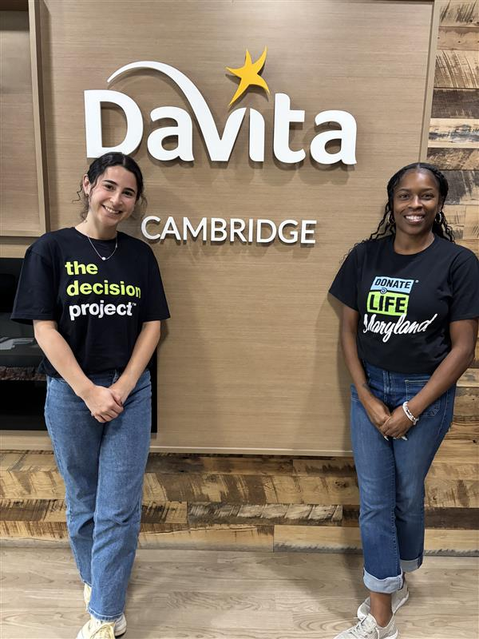
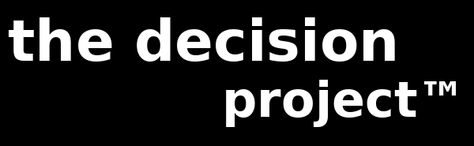
COMMUNITY-ENGAGED
TRANSPLANT EDUCATION
IN DIALYSIS CENTERS
A Model for Reducing Transplant Barriers
Ieesha Johnson, MS
Executive Director, The Decision Project™
Infinite Legacy

Slide 2





Session Overview
The Problem
The Model
The Data
The Impact
Misconceptions and barriers in dialysis communities
Infinite Legacy x DaVita partnership, launched 2025
600+ patients reached across 5 locations
Stories, feedback and what comes next

Slide 3

The Problem
"If my husband gets a transplant, does that mean he won't have to do dialysis anymore?"
Overheard at a lobby day. A simple question that reveals a profound gap.
1
2
3
Misconceptions
Access Barriers
Missed Opportunities
Patients and families often conflate living and deceased donation, or don't know transplant can eliminate dialysis
Dialysis centers are high-need settings yet rarely reached by OPO education teams
Without proactive education, patients may never ask to be listed or know they qualify

Slide 4



Understanding Our Patients
Dialysis patients face compounding barriers that go beyond the clinic walls:
Transportation
Health Literacy
Medical Mistrust
Many patients depend on medical transport or others for rides. Getting to appointments is already a burden, making additional engagement difficult.
Complex medical terminology around transplant, donation, and eligibility creates confusion and discourages patients from asking questions or advocating for themselves.
Historical mistreatment of communities of color in medicine creates deep-seated distrust. Patients may avoid or delay care, and be skeptical of new information.
DaVita has designated Infinite Legacy as a Community Resource, not a vendor, allowing free access to patients with no conflict of interest.

Slide 5
Who We Are Serving
Community profiles across our service areas (2024 data)
Community
Population
% Black
Poverty Rate
Median HH Income
Medicaid %
Chestertown
5,594
22%
11.6%
$54,346
15%
Cambridge
13,152
44%
26.4%
$47,323
44%
Easton
17,308
16%
11.0%
$74,653
N/A
Denton
4,936
25%
12.8%
$66,510
N/A
Baltimore City
573,243
58%
19.7%
$62,177
N/A
Cambridge and Baltimore City have the highest proportions of Black residents and Medicaid enrollment, indicating greatest need.

Slide 6
The Data Understates the Need
Census data is tied to a city or ZIP code, not to where patients actually come from.
DaVita Chestertown's census shows a population of 5,594 and 22% Black. But its patients travel from Rock Hall, Sudlersville, Centreville, Church Hill, Kent Island, and parts of Delaware, drawing from a county that is 14% Black with a 9.7% poverty rate and a median income well below Maryland's state average.
What the City Census Shows
What the County Catchment Shows
Chestertown city population
5,594
Kent County population
19,303
% Black (city)
22%
% Black (county)
14%
Poverty rate (city)
11.6%
Poverty rate (county)
9.7%
Median HH income (city)
$54,346
Dorchester County poverty rate
17.1%
Facilities are often in wealthier city centers. The patients they serve reflect the surrounding rural, lower-income communities.

Slide 7

From the Chair: A Dialysis Technician's Perspective
Janet S. | Dialysis Technician
On Survival Mode
On Trust First
On Why It Matters
Education alone is not enough. Trust has to come first. When patients feel seen, heard and respected, the questions come. The interest comes. The hope comes. And that is when lives begin to change.
Many dialysis patients are in survival mode. They are managing treatments, medications, transportation, employment, finances, dietary restrictions and the physical and emotional toll of kidney failure. When you are focused on making it through today, it can be difficult to think about what might be possible tomorrow.
Federal regulations recognize the importance of educating patients about transplant and living donation, as it offers opportunities beyond maintenance of life. Programs that bring these conversations directly to the dialysis setting help ensure patients are aware of their options and empowered to pursue them.

Slide 8
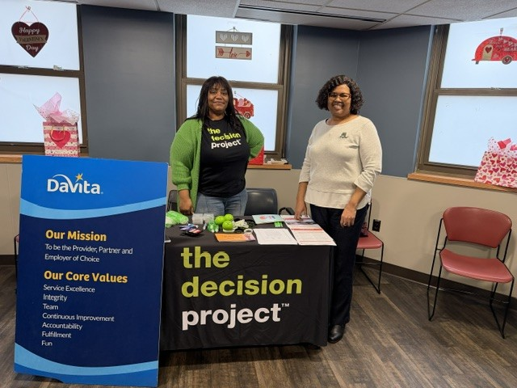


The Partnership
Infinite Legacy x DaVita
Partnership launched July 2025, bringing organ donation education directly into dialysis treatment centers
Eastern Shore focus: Chestertown, Cambridge, and Easton in 2025
Culturally responsive, in-center education during patient treatment visits
Expanding in 2026 to Denton, Baltimore City Union, and beyond
Meet patients where they are, in the chair, during treatment.

Slide 9
Where We Show Up
DaVita Chestertown
2025 + 2026
DaVita Denton
NEW 2026
Kent County
Caroline County
DaVita Cambridge
2025 + 2026
DaVita Baltimore City (Union)
NEW 2026
Dorchester County
Baltimore City
DaVita Easton
2025 + 2026
Fresenius (Eastern Shore)
Summer 2026
Talbot County
Eastern Shore
Annapolis + Glen Burnie
Summer 2026
Anne Arundel County

Slide 10
Patients Reached: July 2025 to Present
564
285
Total patients reached
Patients reached in 2025
July 2025 to June 2026
July through December 2025
279
24
Patients reached in 2026
Total lobby days conducted
January through June 2026
Across all 5 locations

Slide 11
2026 Lobby Days by Location
2026 YTD
279
Patients
reached
13
Lobby days
conducted
5
Locations
served

Slide 12

What We Hear
These conversations are giving me hope.
Thank you for being here. I am learning more every time I see you.
I feel more confident in talking with my doctor about transplantation.
Dialysis Patient
Dialysis Patient
Dialysis Patient
"I just wanted to thank you for coming to our Chestertown clinic and offering education to our patients. I appreciate you and your organization trying to help our patients and people with kidney disease in general."
Mike, Social Worker, DaVita Chestertown

Slide 13


Change We Can See
What dialysis center staff are observing since lobby days began:
Patients are proactively checking whether they are or can be on the transplant list
Lobby Days, combined with hiring a dedicated social worker, is driving an increase in transplant list enrollment
Patients are having more conversations about organ transplantation, with staff and with each other

Slide 14
Why This Work Matters
Ms. Sophia
A patient on dialysis for years. She was scared to get a transplant. Her vulnerability reminded me why we must continue to show up for our communities, to build trust, and to meet people where they are.
Cami
Sick since age three. More than 25 surgeries. Still waiting for a kidney, vibrant, energetic, and full of hope. She told me: "I'm just waiting for the call." That's what hope looks like.

Slide 15
A Replicable Model
What makes this approach work and what you can replicate:
Identify a High-Need Setting
Keep It Accessible
1
4
Dialysis centers concentrate patients who need transplant education most. Partner with the facility administrator and social workers.
Plain language. One-on-one conversation. Meet the patient where they are, emotionally and informationally.
Build Relationships First
Track and Adapt
2
5
Trust with staff before patients. Respect the clinical environment. Consistent, friendly presence earns access.
Document every engagement. Let data and staff feedback guide where to expand and how to improve.
Show Up Consistently
3
Monthly lobby days maintain momentum. Patients recognize you visit to visit. Trust compounds.

Slide 16
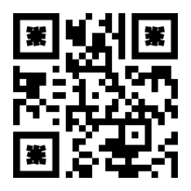

The Call Is Coming.
Are your patients ready to answer it?
✓ Partner with dialysis centers to reach patients at the highest risk of waiting too long
✓ Consistent, in-person education builds trust that changes behavior, not just awareness
✓ This model is replicable. Start small. Show up. Let the data guide expansion.
Questions? Let's connect.
Ieesha Johnson, MS · Executive Director, The Decision Project™ · Infinite Legacy

